Slide 1
Assignment 3 Writeup DO NOT TAG
Name: Bing Yang
GT Email: byang322@gatech.edu

Slide 2
Visualization
DO NOT TAG

Slide 3
Saliency Map
Include your saliency map here

Slide 4
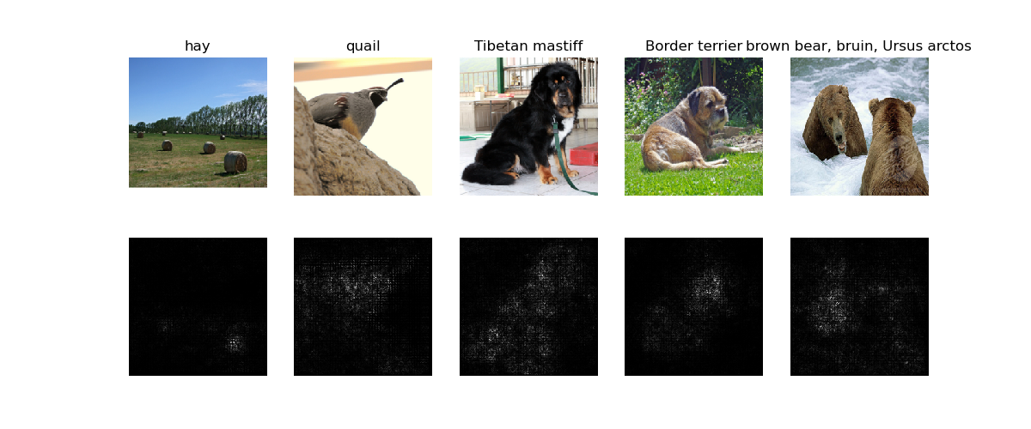

Slide 5
Saliency Map
Include your saliency map from Captum here

Slide 6
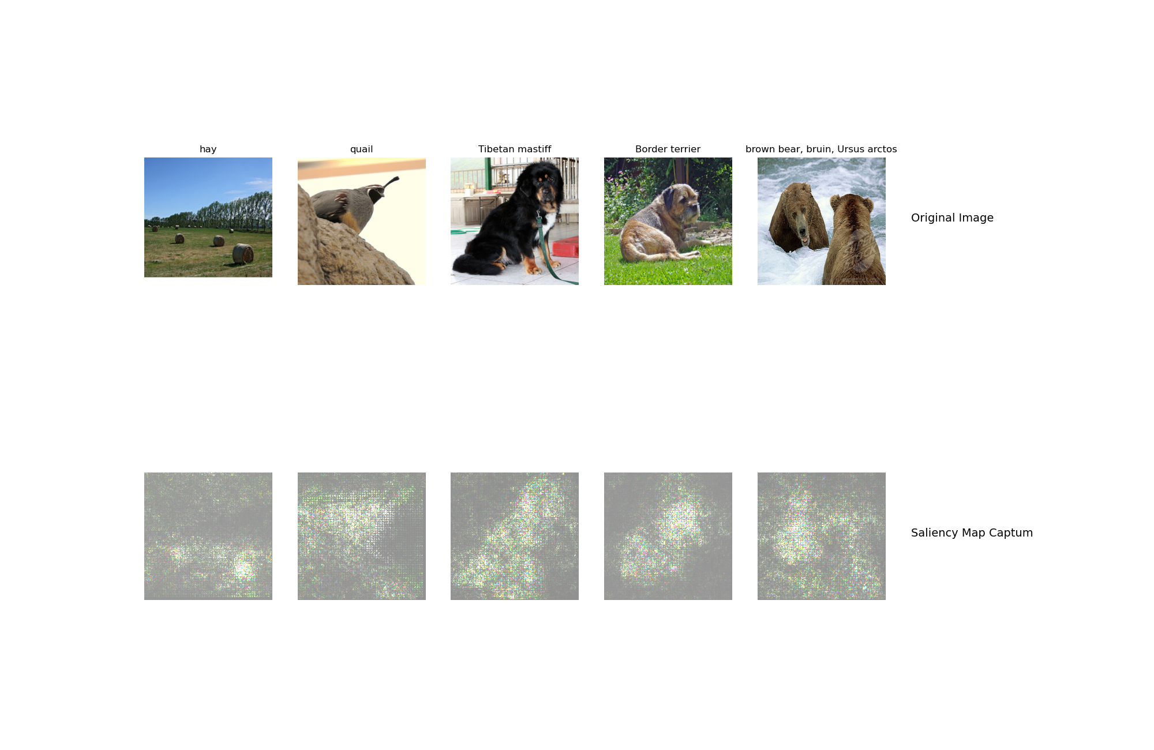

Slide 7
GradCam
Include your visualization of Guided Backprop here

Slide 8
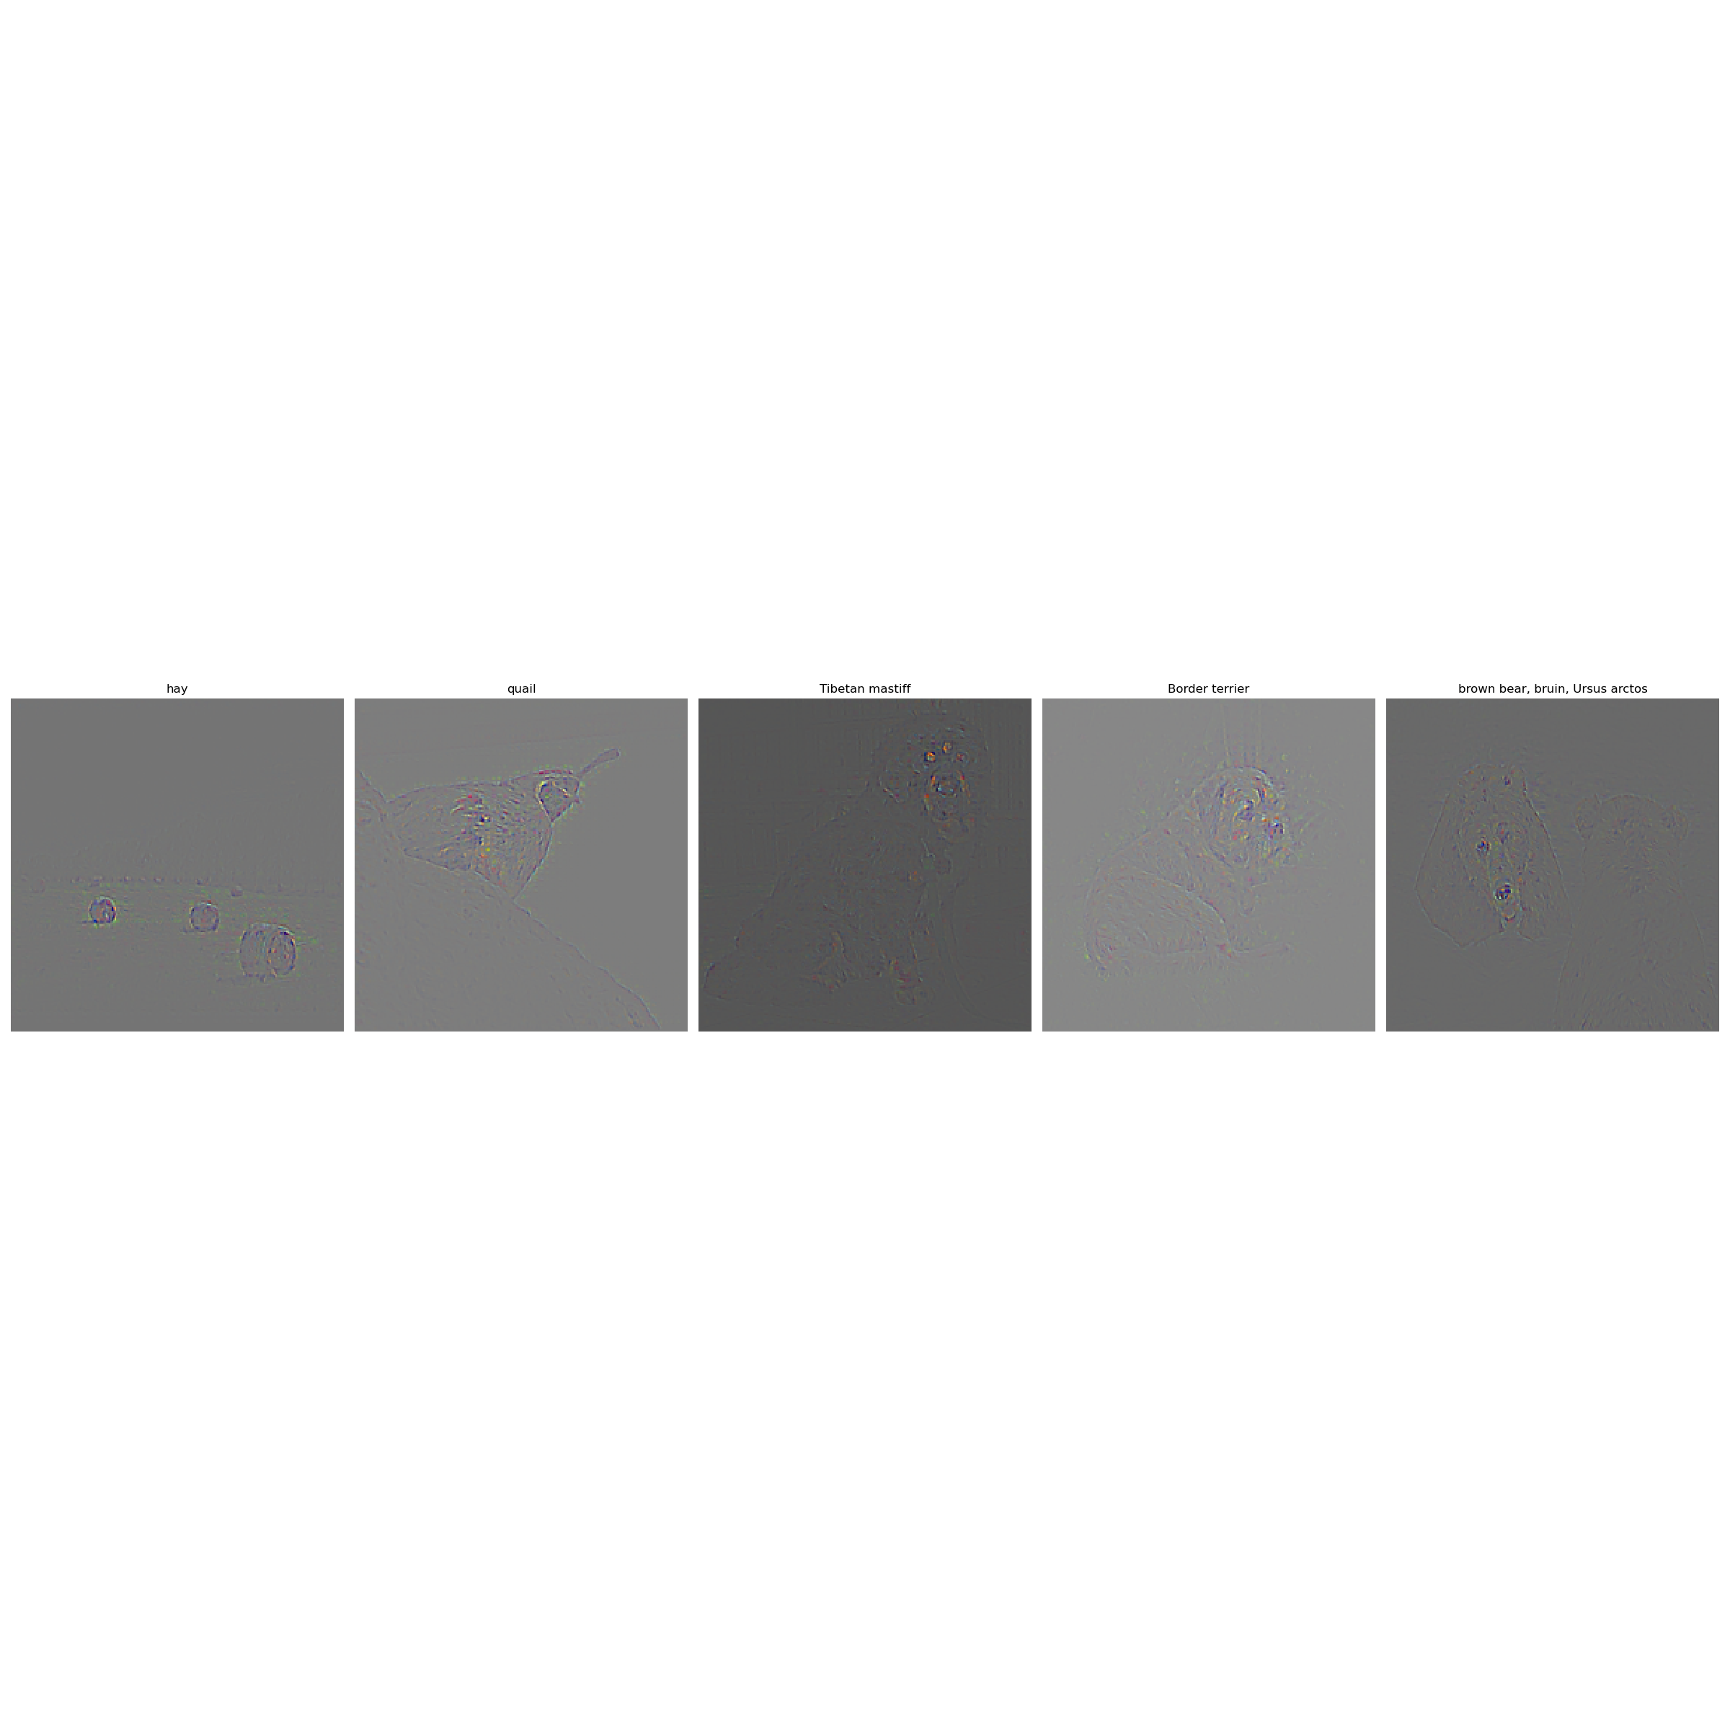

Slide 9
GradCam
Include your visualization of GradCam here

Slide 10
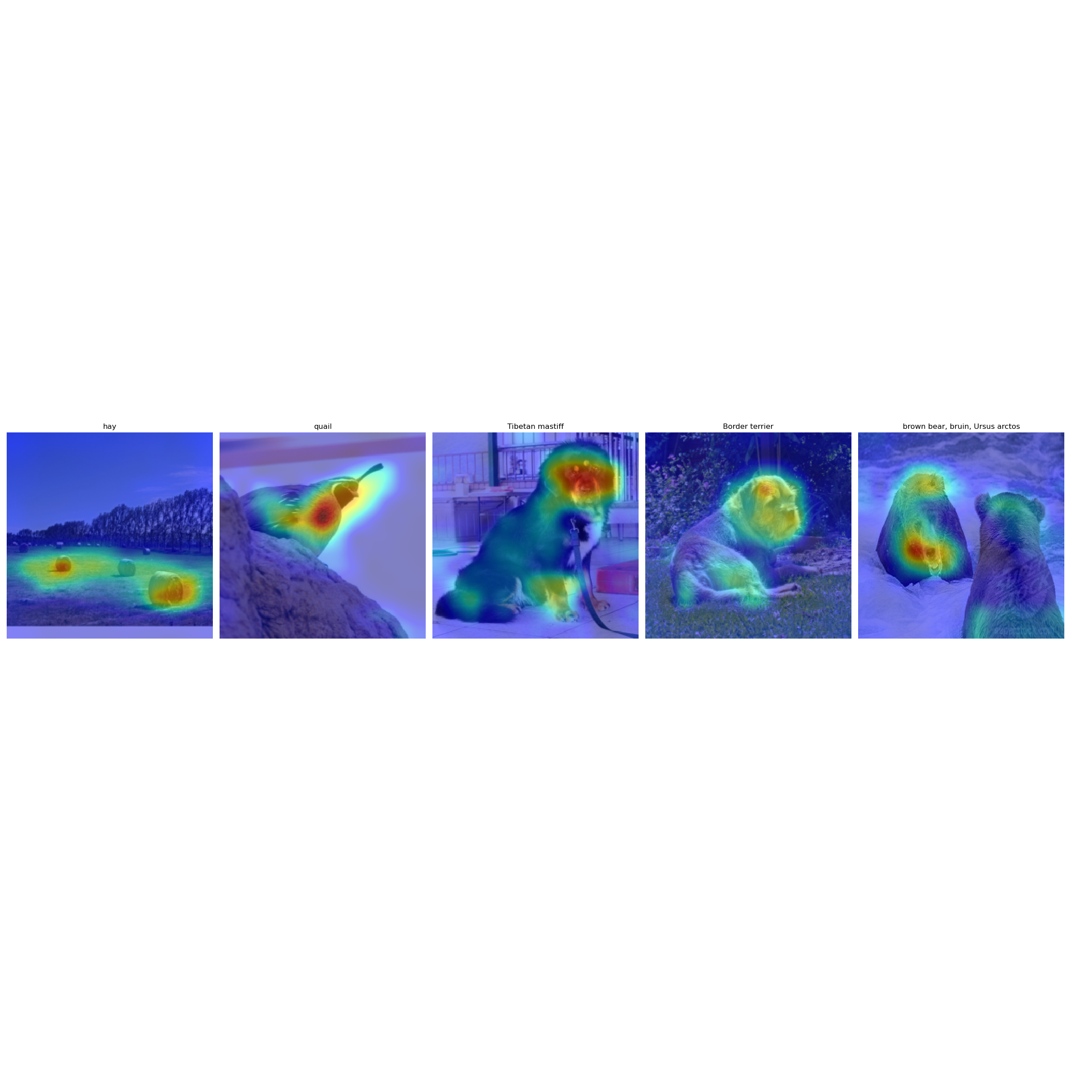

Slide 11
GradCam
Include your visualization of Guided GradCam here

Slide 12
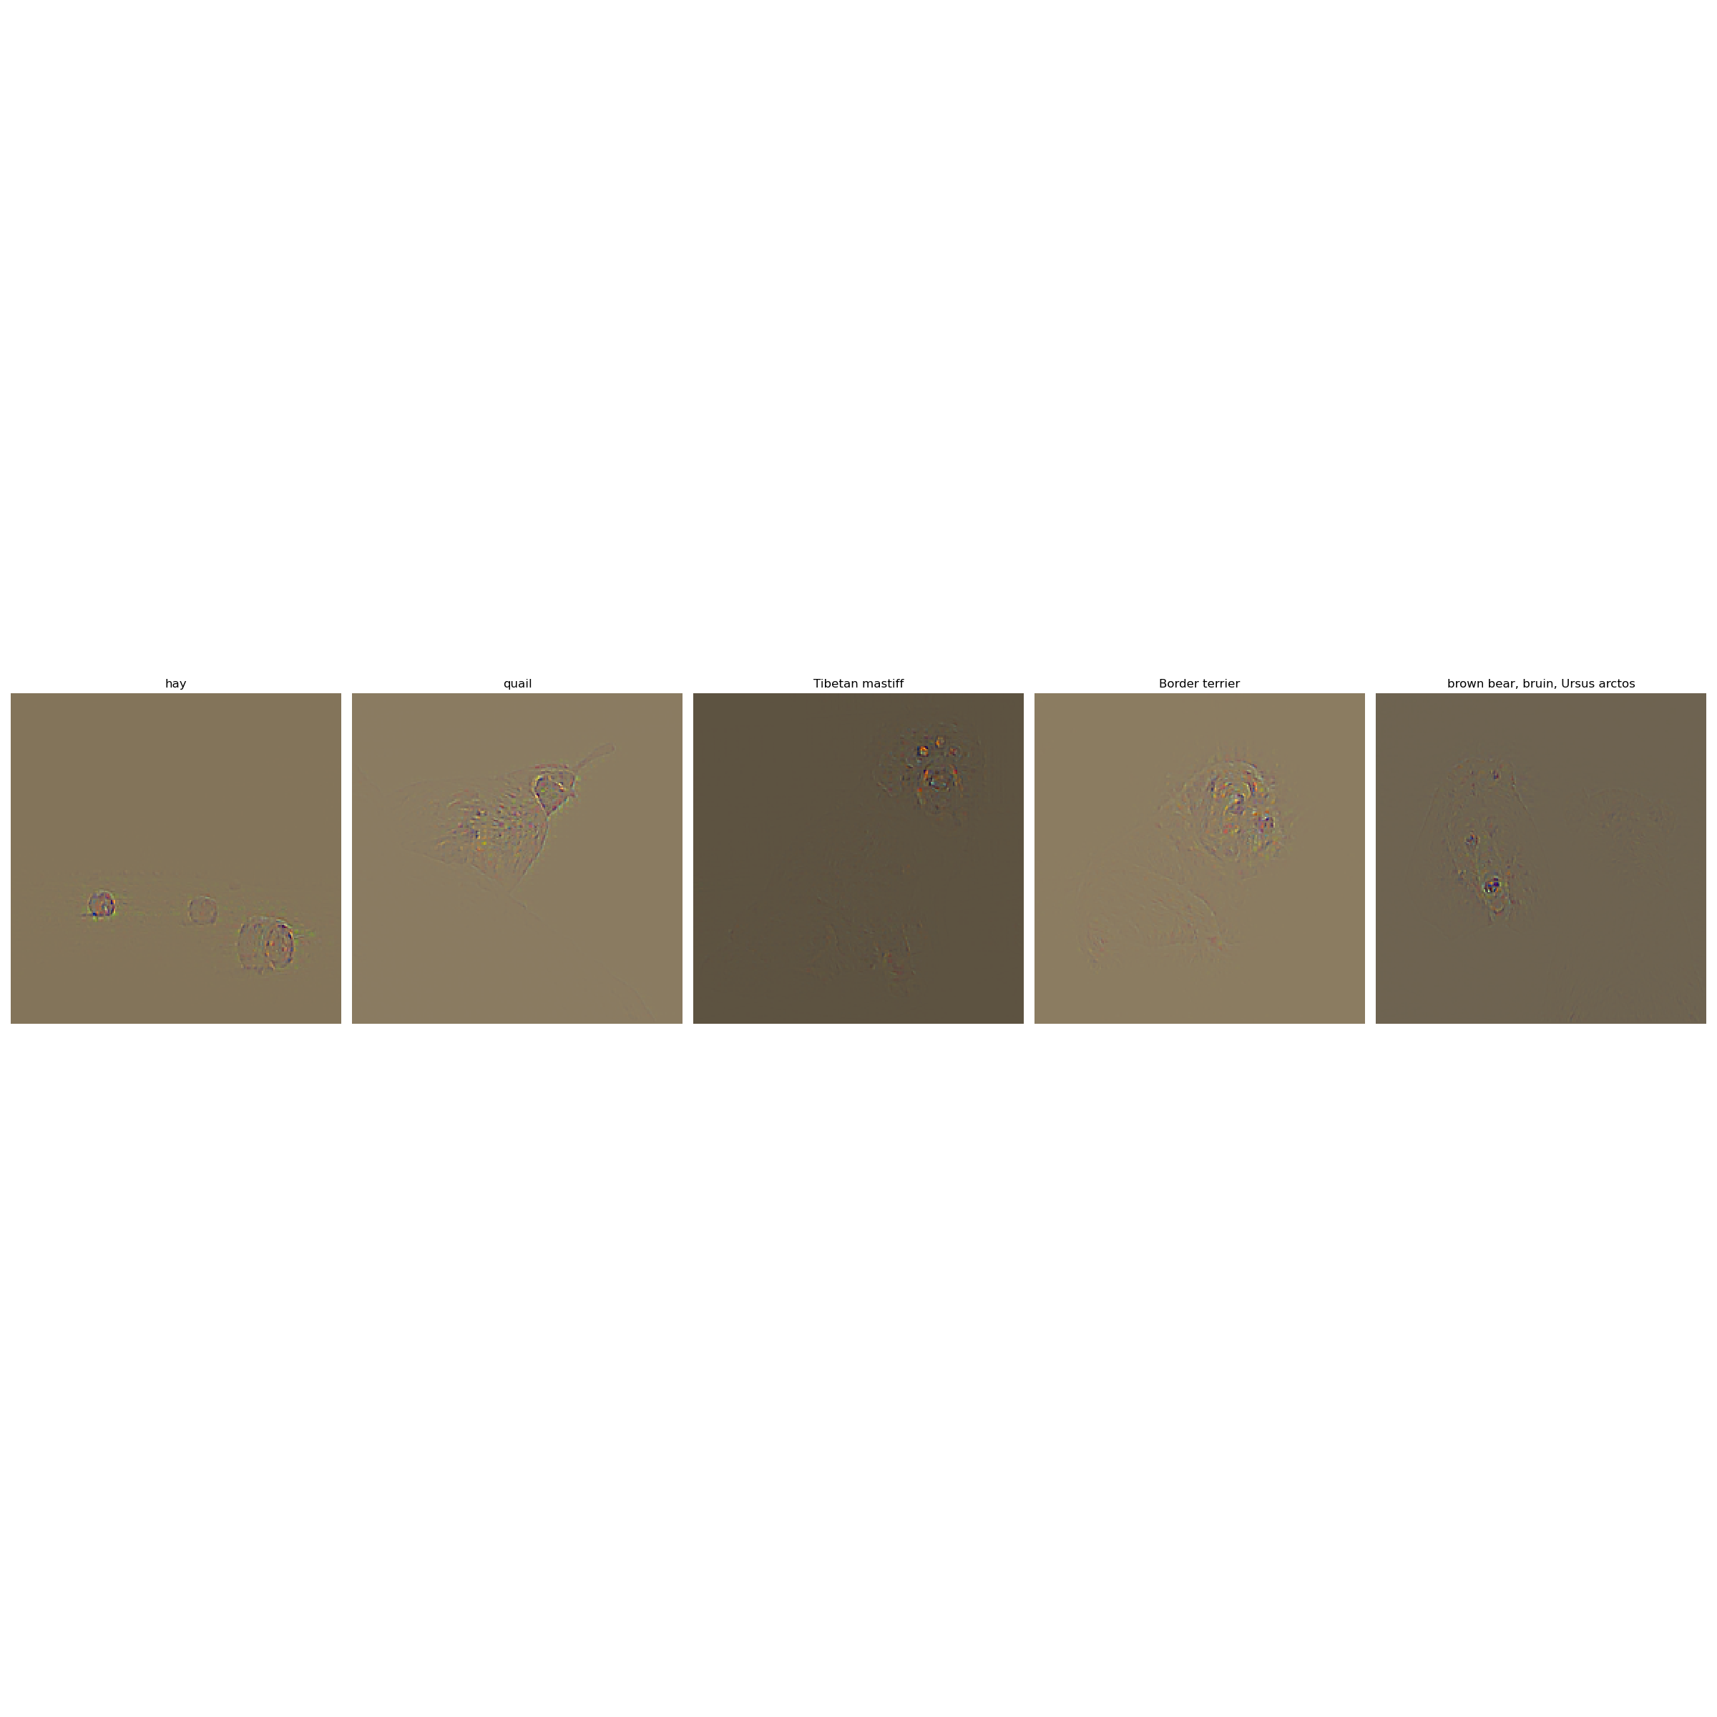

Slide 13
GradCam
Include your visualization of Guided Backprop and Guided Gradcam from Captum here

Slide 14
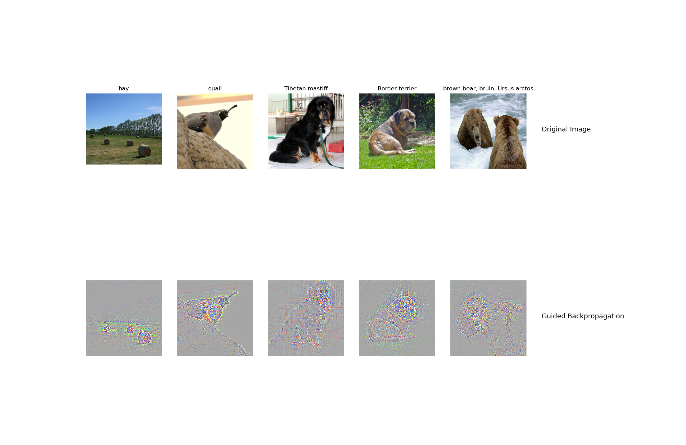

Slide 15
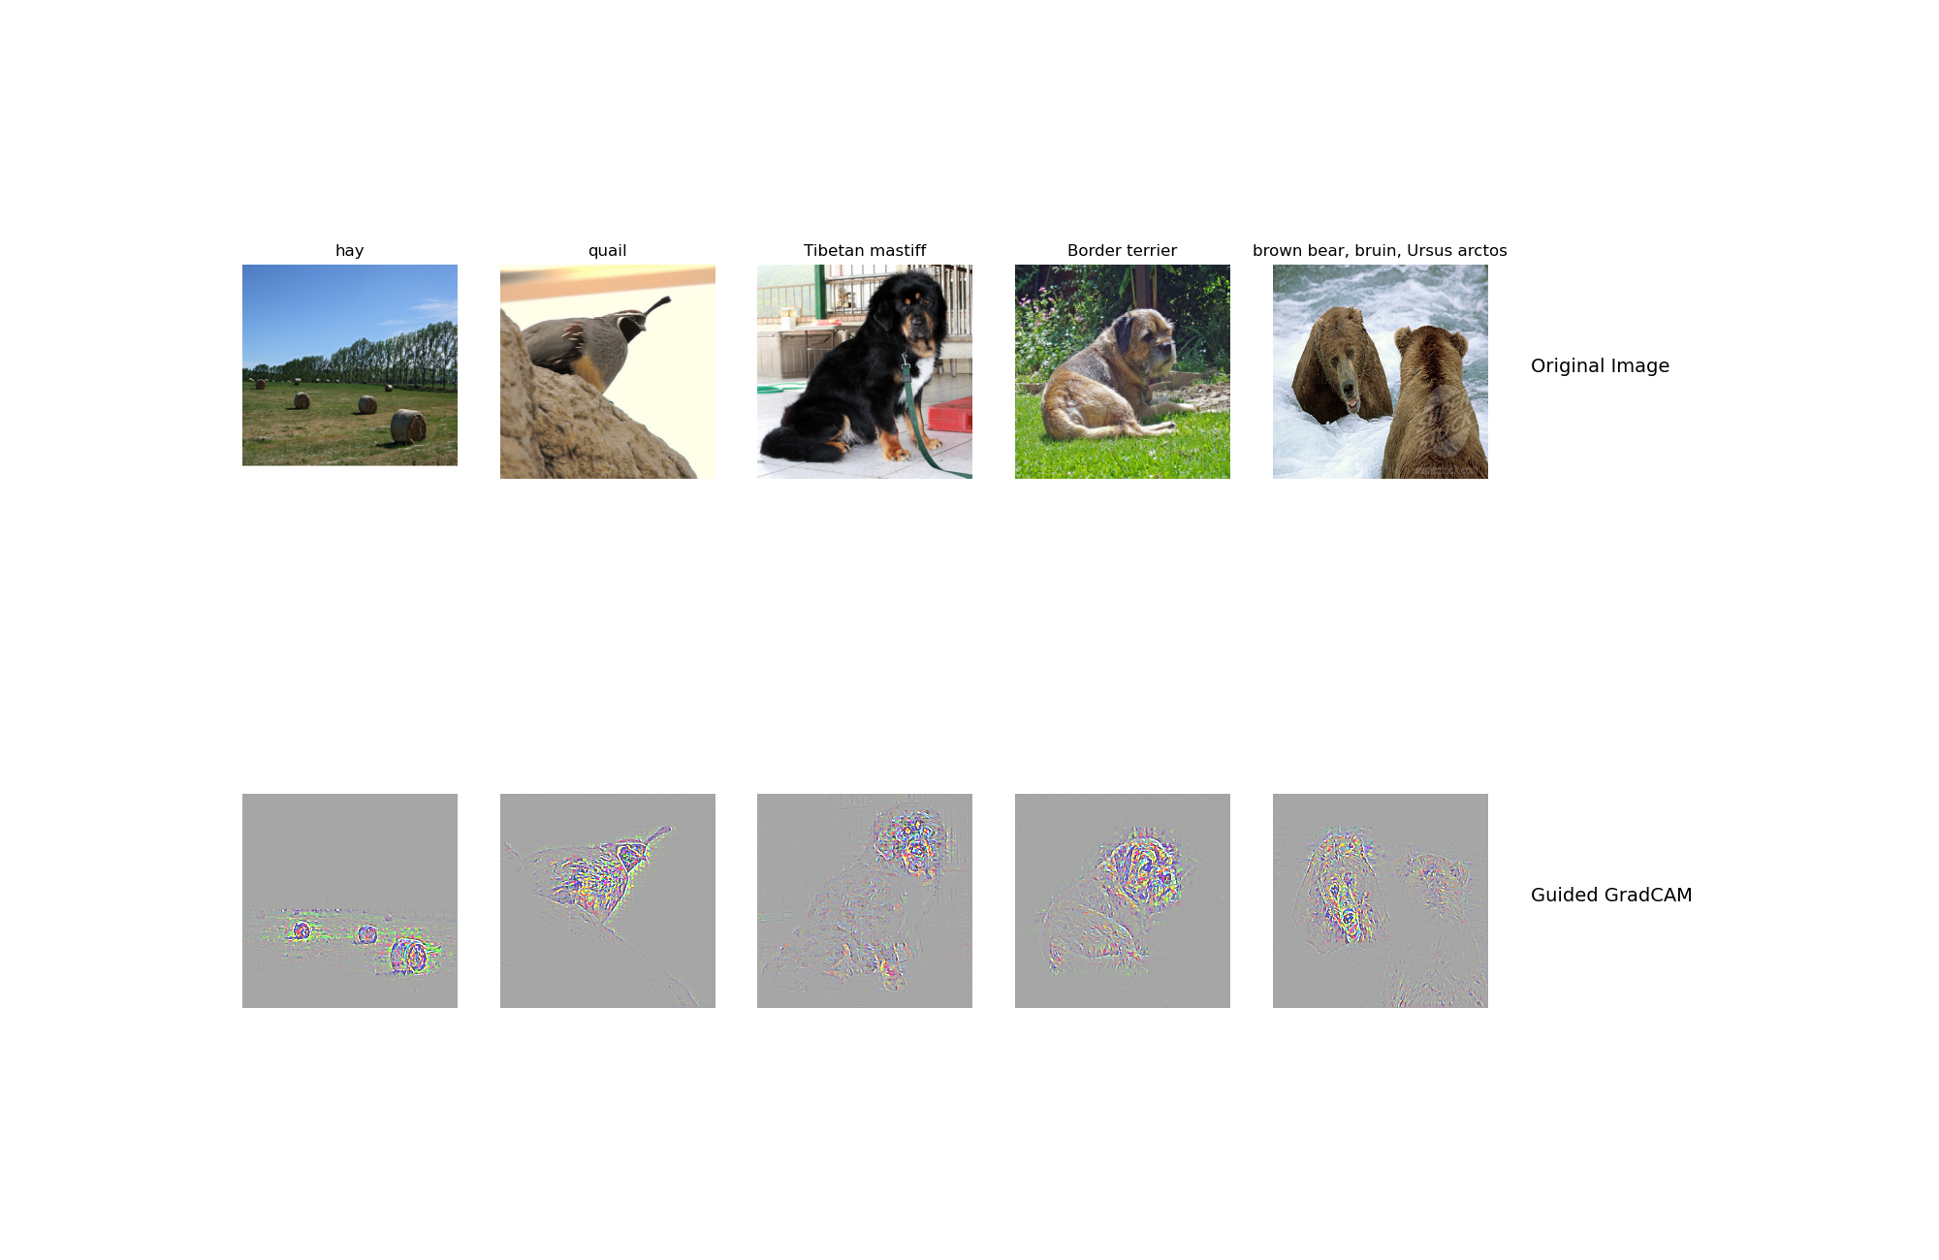

Slide 16
GradCam
Visualization of layers and neurons using Captum here:

Slide 17
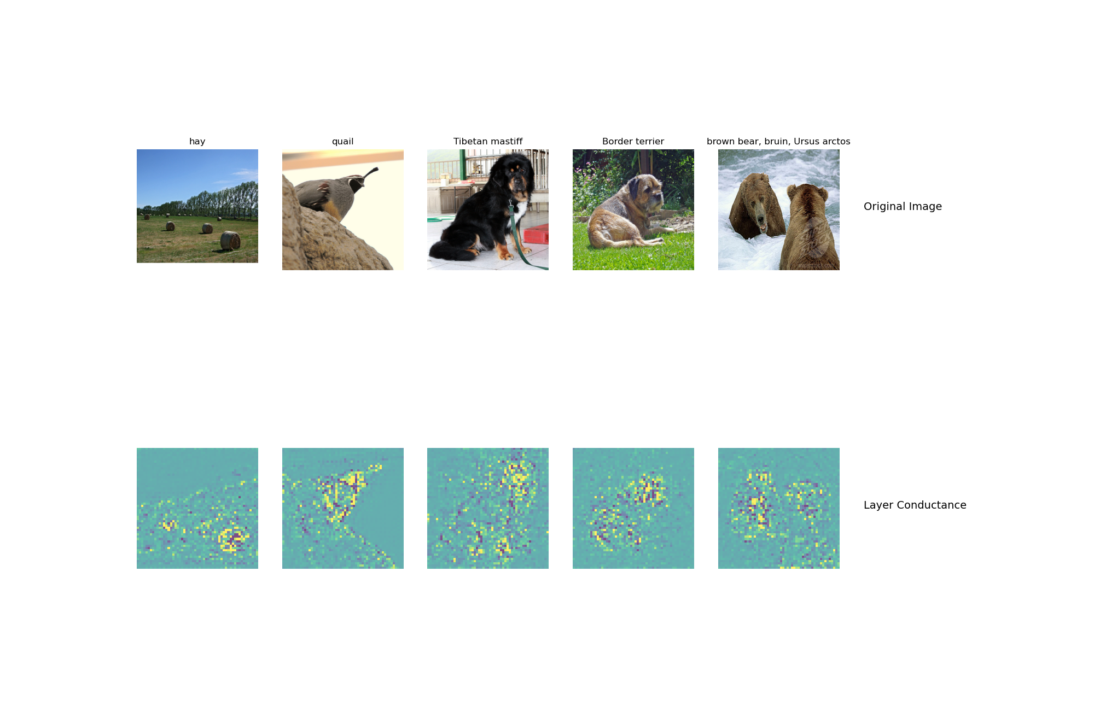

Slide 18
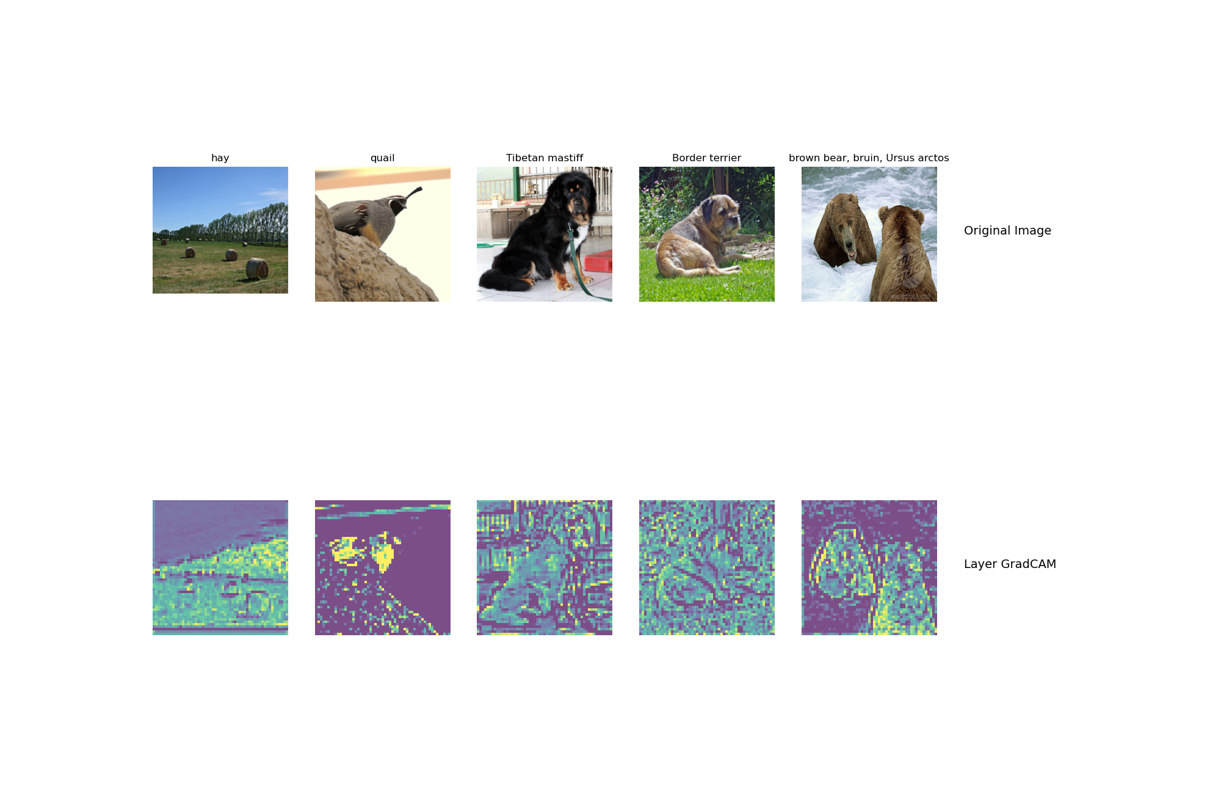

Slide 19
What do saliency map and Gradcam tell you
Answer:
In short answer, both saliency map and gradcam can give the information on what regions in the input images are important for the final classification problem given the correct class label.
Saliency map could be understood as a mask showing where in the image the objects used for classification are.
Gradcam shows what regions are mostly captured in the final convolutional layer (or previous layers).

Slide 20
Fooling Image
Include the fooling image here

Slide 21
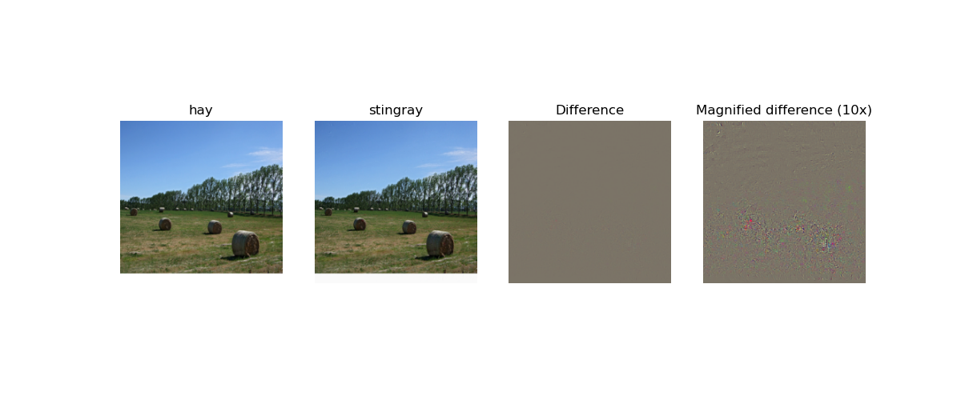

Slide 22
Fooling Image
What insights do you get from fooling images:
Answer:
The difference between raw image and fooling image is not noticeable to human eyes. This suggests for this model it is sensitive to adversarial attack. We need to use those fooling images during training to increase the performance of the deep learning model.

Slide 23
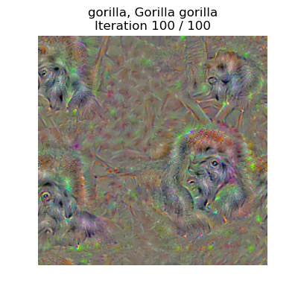
Class Visualization
Include class visualization of Gorilla here

Slide 24
Style Transfer
DO NOT TAG

Slide 25
Composition VII + Tubingen
Include both original images and the transferred image

Slide 26
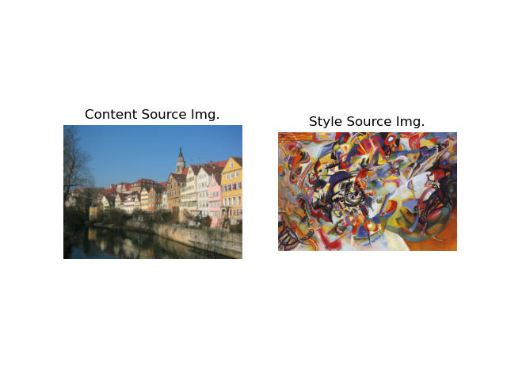

Slide 27
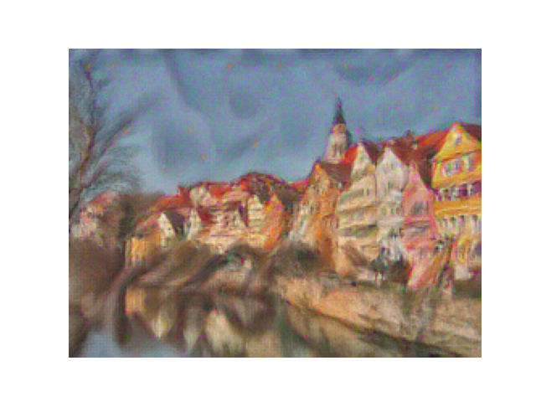

Slide 28
Scream + Tubingen
Include both original images and the transferred image

Slide 29
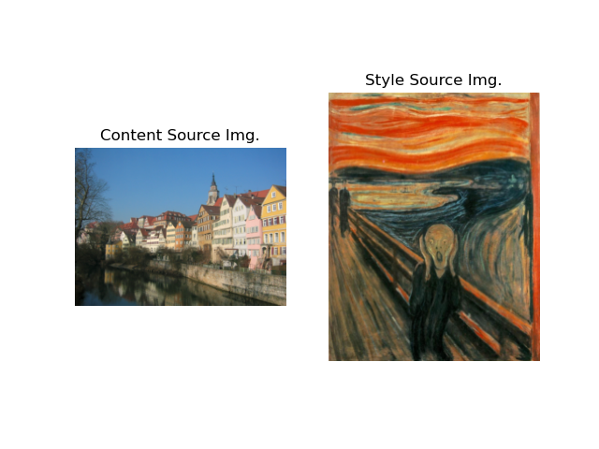

Slide 30
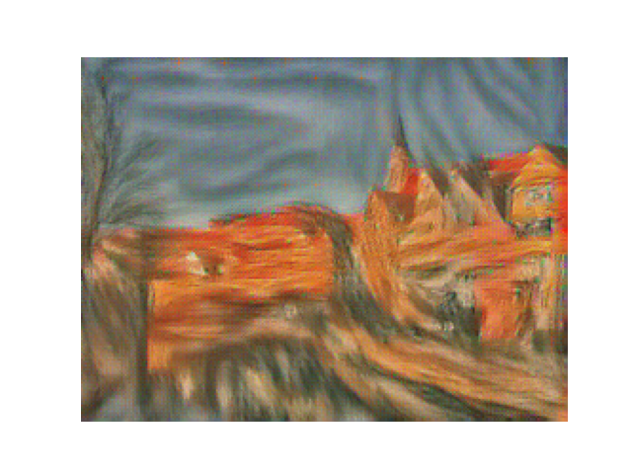

Slide 31
Starry Night + Tubingen
Include both original images and the transferred image

Slide 32
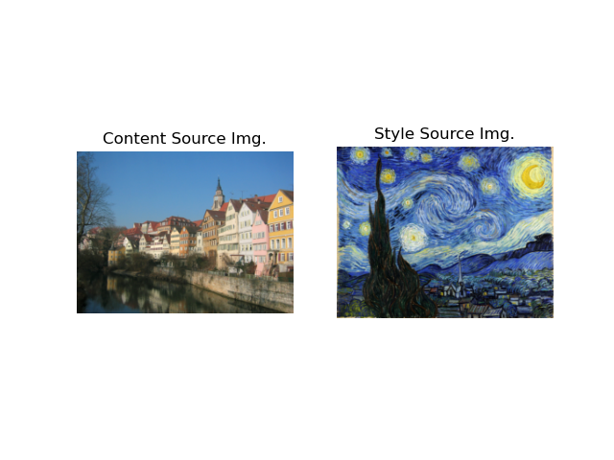

Slide 33
